Slide 1
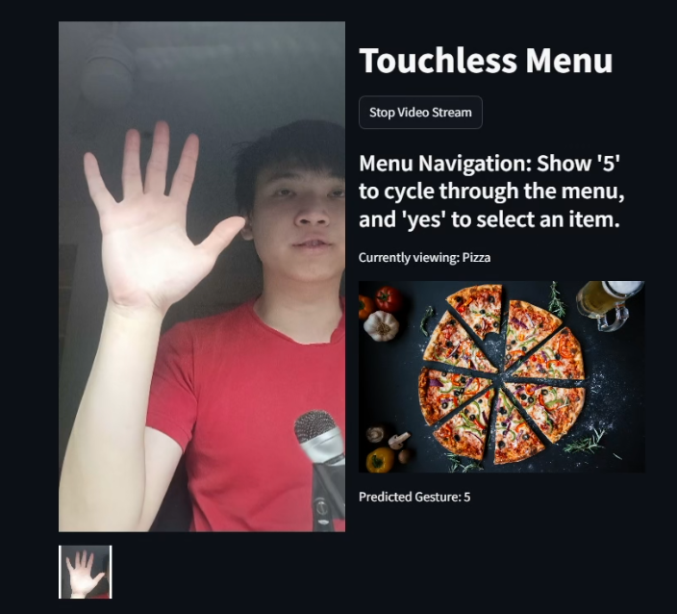
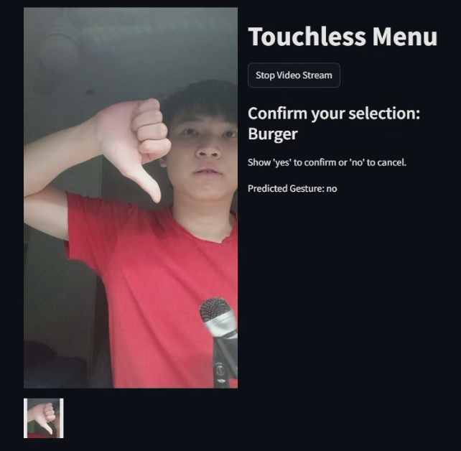
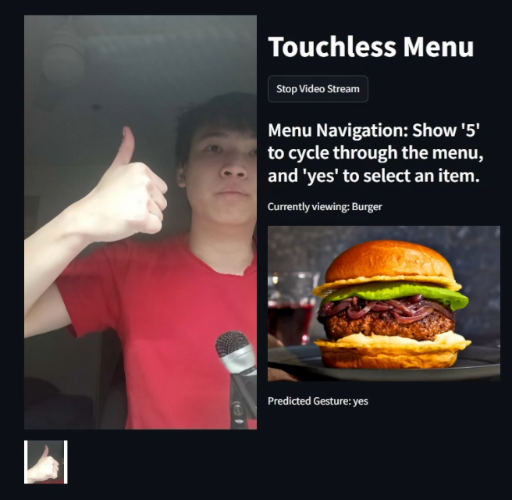
Hands-Free Food Ordering: A Gesture-Based Interface for Restaurants
Hoang Long Tran (s223128143)

Slide 2
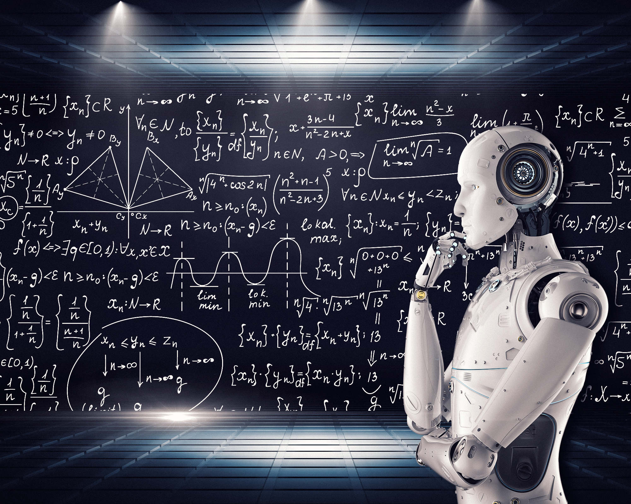
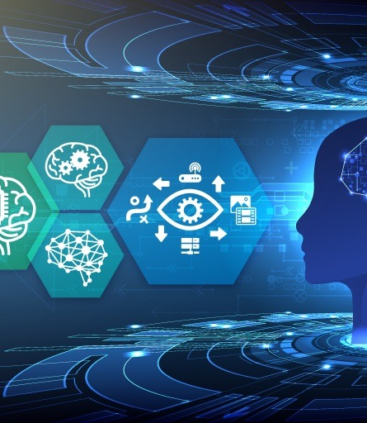
Introduction
Traditional food order rely too much on verbal communication -> difficult for those with hearing problems.
Make use of Computer Vision to create hand gesture prediction system. Suitable for drive-through and restaurant settings.

Slide 3
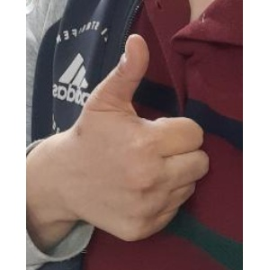
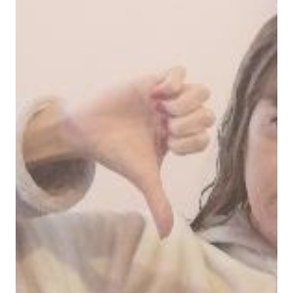
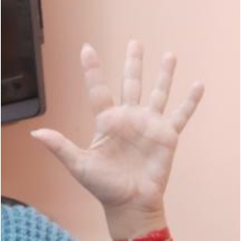
Data collection
Use open repos and scape images
Use Mediapipe and OpenCV to crop out image hands

Slide 4
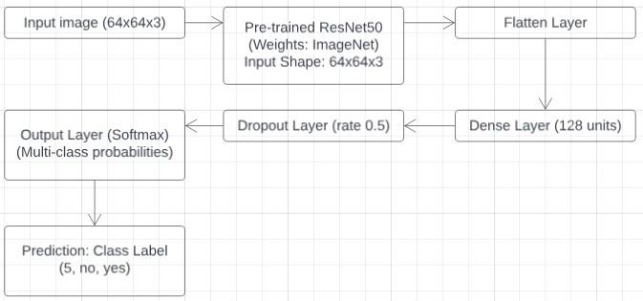
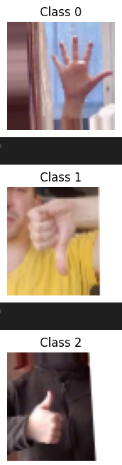
Model Architecture
Feed cropped images into pre-trained ResNet50 to predict gestures “5”, “yes”, “no”.

Slide 5
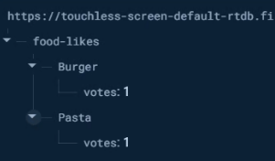
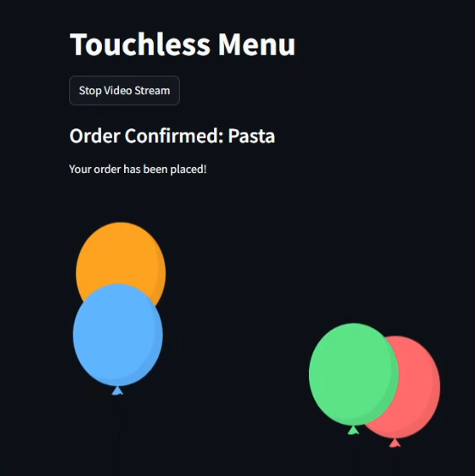
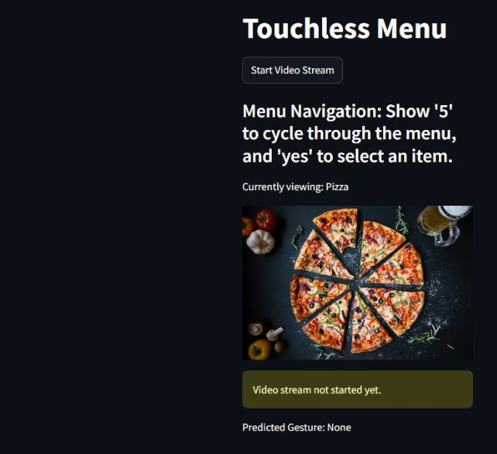
Live Demonstration

Slide 6
Conclusion
System did a good job, but there are rooms to improve.
Expand the model for more gestures and reduce the delay.

